Slide 1
CSE 205: Digital Logic Design
Dr. Tanzima Hashem
Professor
CSE, BUET

Slide 2
Logic Circuits
Logic Circuits: Combinational and Sequential
Combinational Circuits
A combinational circuit consists of logic gates whose outputs at any time are determined from only the present combination of inputs
Sequential Circuits
A sequential circuits employ storage elements and logic gates
The outputs are a function of the inputs and the state of the storage elements.
The state of the storage elements, in turn, is a function of the previous inputs (and the previous state)

Slide 3
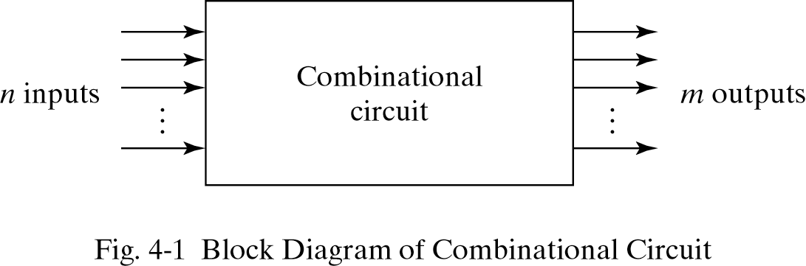
Combinational Circuits
The n input binary variables come from an external source.
The m output variables are produced by the internal combinational logic circuit and go to an external destination.

Slide 4
Combinational Circuits
Analysis
Given a circuit, find out its function
Function may be expressed as:
Boolean function
Truth table
Design
Given a desired function, determine its circuit
Function may be expressed as:
Boolean function
Truth table
?
?
?

Slide 5
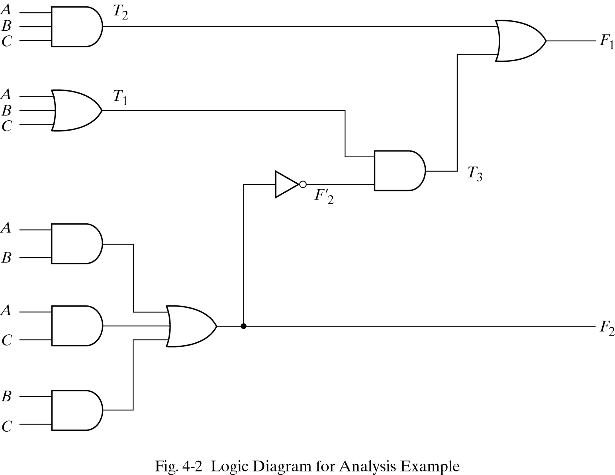
Analysis Procedure Boolean Expression Approach
F₂ = AB + AC + BC
T₁ = A + B + C
T₂ = ABC
T₃ = F₂´ T₁
F₁ = T₃ + T₂
Or
F₁ = A´BC´ + A´B´C + AB´C´ + ABC

Slide 6
Analysis Procedure Truth Table Approach
A
0
0
0
0
1
1
1
1
B
0
0
1
1
0
0
1
1
C
0
1
0
1
0
1
0
1
F₂
0
0
0
1
0
1
1
1
F₂ ´
1
1
1
0
1
0
0
0
T₁
0
1
1
1
1
1
1
1
T₂
0
0
0
0
0
0
0
1
T₃
0
1
1
0
1
0
0
0
F₁
0
1
1
0
1
0
0
1

Slide 7
Design Procedure
Given a problem statement:
Determine the number of inputs and outputs
Derive the truth table
Simplify the Boolean expression for each output
Produce the required circuit and verify it
Example:
Design a circuit to convert a “BCD” code to “Excess 3” code
4-bits
0-9 values
?
4-bits
Value+3

Slide 8
Design Procedure BCD-to-Excess 3 Converter
 |  |  |  | C
 |  |  | 1 | 1 | 1 | B
A |  | x | x | x | x
 |  | 1 | 1 | x | x
 |  |  | D
 |  |  |  | C
 |  |  | 1 | 1 | 1
 |  | 1 |  |  |  | B
A |  | x | x | x | x
 |  |  | 1 | x | x
 |  |  | D
A B C D | w x y z
0 0 0 0 | 0 0 1 1
0 0 0 1 | 0 1 0 0
0 0 1 0 | 0 1 0 1
0 0 1 1 | 0 1 1 0
0 1 0 0 | 0 1 1 1
0 1 0 1 | 1 0 0 0
0 1 1 0 | 1 0 0 1
0 1 1 1 | 1 0 1 0
1 0 0 0 | 1 0 1 1
1 0 0 1 | 1 1 0 0
1 0 1 0 | x x x x
1 0 1 1 | x x x x
1 1 0 0 | x x x x
1 1 0 1 | x x x x
1 1 1 0 | x x x x
1 1 1 1 | x x x x
w = A+BC+BD
x = B’C+B’D+BC’D’
 |  |  |  | C
 |  | 1 |  | 1
 |  | 1 |  | 1 |  | B
A |  | x | x | x | x
 |  | 1 |  | x | x
 |  |  | D
 |  |  |  | C
 |  | 1 |  |  | 1
 |  | 1 |  |  | 1 | B
A |  | x | x | x | x
 |  | 1 |  | x | x
 |  |  | D
y = C’D’+CD
z = D’

Slide 9
Design Procedure BCD-to-Excess 3 Converter
A B C D | w x y z
0 0 0 0 | 0 0 1 1
0 0 0 1 | 0 1 0 0
0 0 1 0 | 0 1 0 1
0 0 1 1 | 0 1 1 0
0 1 0 0 | 0 1 1 1
0 1 0 1 | 1 0 0 0
0 1 1 0 | 1 0 0 1
0 1 1 1 | 1 0 1 0
1 0 0 0 | 1 0 1 1
1 0 0 1 | 1 1 0 0
1 0 1 0 | x x x x
1 0 1 1 | x x x x
1 1 0 0 | x x x x
1 1 0 1 | x x x x
1 1 1 0 | x x x x
1 1 1 1 | x x x x
w = A + B(C+D)
y = (C+D)’ + CD
x = B’(C+D) + B(C+D)’
z = D’

Slide 10
Binary Adder
The most basic arithmetic operation is the addition of two binary digits.
A combinational circuit that performs the addition of two bits is half adder
A adder performs the addition of 2 significant bits and a previous carry is called a full adder

Slide 11
Binary Adder
Half Adder
Adds 1-bit plus 1-bit
Produces Sum and Carry
x
y
S
C
HA
x
+ y
───
C S
x y | C S
0 0 | 0 0
0 1 | 0 1
1 0 | 0 1
1 1 | 1 0
x
y
S
C

Slide 12
Binary Adder
x
y
z
S
C
FA
Full Adder
Adds 1-bit plus 1-bit plus 1-bit
Produces Sum and Carry
x
+ y
+ z
───
C S
x y z | C S
0 0 0 | 0 0
0 0 1 | 0 1
0 1 0 | 0 1
0 1 1 | 1 0
1 0 0 | 0 1
1 0 1 | 1 0
1 1 0 | 1 0
1 1 1 | 1 1
 |  |  |  | y
 |  | 0 | 1 | 0 | 1
x |  | 1 | 0 | 1 | 0
 |  |  | z
S = xy'z'+x'yz'+x'y'z+xyz = x ⊕ y ⊕ z
 |  |  |  | y
 |  | 0 | 0 | 1 | 0
x |  | 0 | 1 | 1 | 1
 |  |  | z
C = xy + xz + yz

Slide 13
Binary Adder
Full Adder
S = xy'z'+x'yz'+x'y'z+xyz = x ⊕ y ⊕ z
C = xy + xz + yz
x
y
z
S
C
S
C
x
y
z

Slide 14
Binary Adder
Full Adder
HA
HA
x
y
z
S
C
S = x ⊕ y ⊕ z
C = (x ⊕ y)z + xy
C = (x ⊕ y)z + xy
x
y
z
x
y
z
S
C
S
C

Slide 15
Binary Adder
x₃x₂x₁x₀ y₃y₂y₁y₀
c₃ c₂ c₁ .
+ x₃ x₂ x₁ x₀
+ y₃ y₂ y₁ y₀
────────
Cy S₃ S₂ S₁ S₀
Binary Adder
Carry Propagate Addition
C_{y}
C₀
S₃S₂S₁S₀
x₃ x₂ x₁ x₀
y₃ y₂ y₁ y₀
0
FA
FA
FA
FA
C₄ C₃ C₂ C₁
S₃ S₂ S₁ S₀

Slide 16
Four-Bit Binary Adder
Carry bits must “ripple” through each stage of a multi-bit adder before the output settles down to the correct result.
Significantly slower --> Rippling effect of carry
For an n bit adder, Propagation delay = (Number of gate level x Average gate delay) x (number of bits)

Slide 17
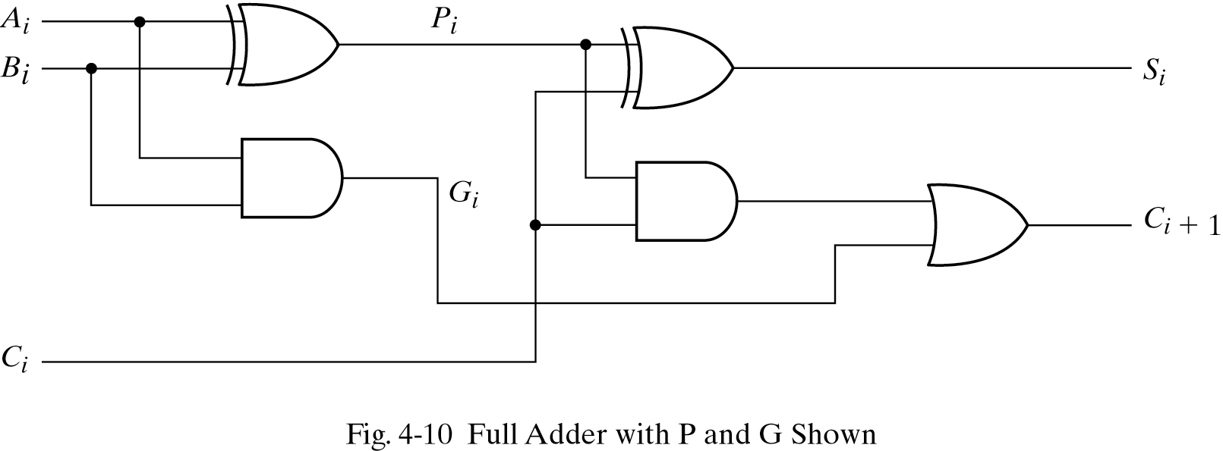
Carry Lookahead Logic
Carry Propagate P_{i} = A_{i} ⊕ B_{i}
Carry Generate G_{i} = A_{i} B_{i}
S_{i} = P_{i} ⊕ C_{i}
C_{i+1} = G_{i} + C_{i} P_{i}

Slide 18
Carry Lookahead Logic
All carries can be generated simultaneously
C₂ = G₁ + P₁C₁
C₃ = G₂ + P₂C₂ = G₂ + P₂G₁ + P₂P₁C₁
C₄ = G₃ + P₃C₃ = G₃ + P₃G₂ + P₃P₂G₁ + P₃ P₂P₁C₁

Slide 19
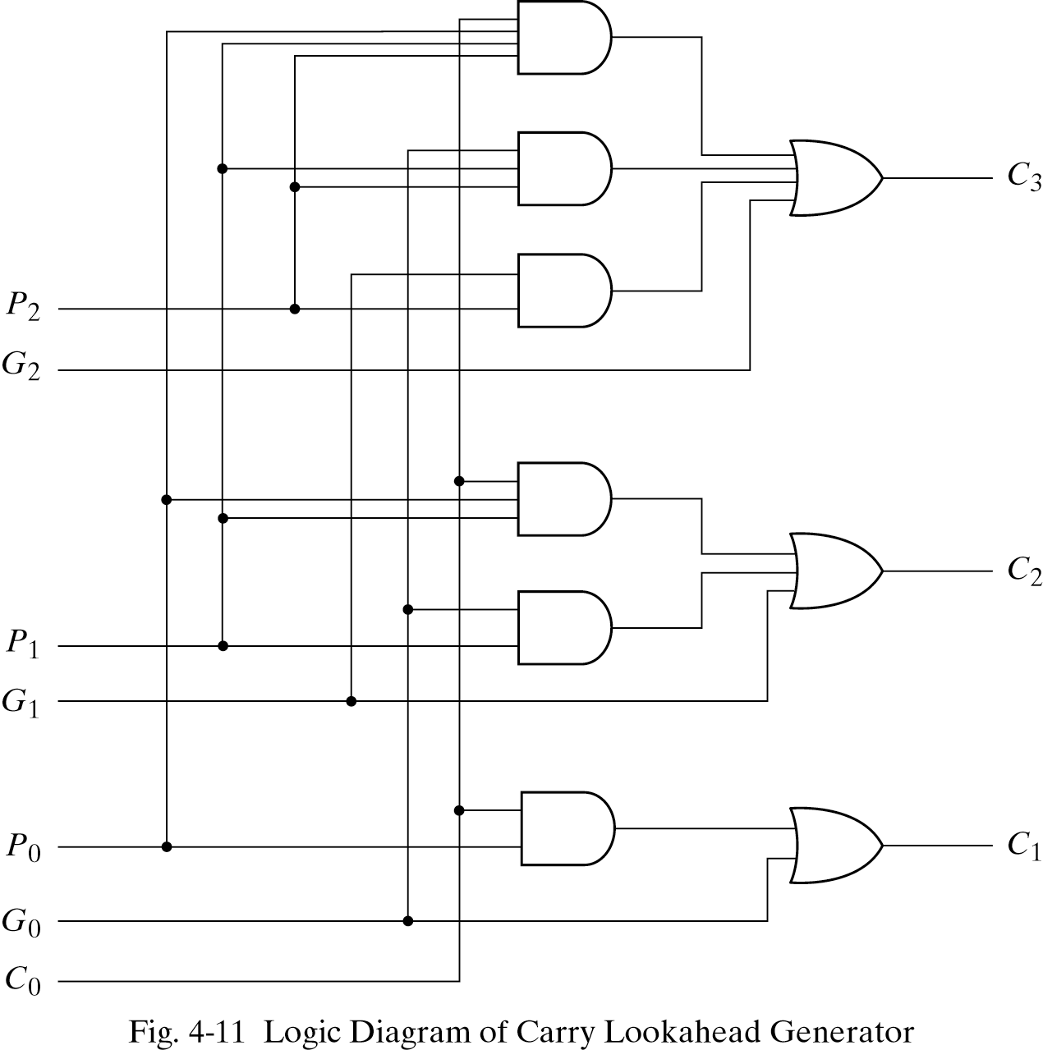
Carry Lookahead Logic

Slide 20
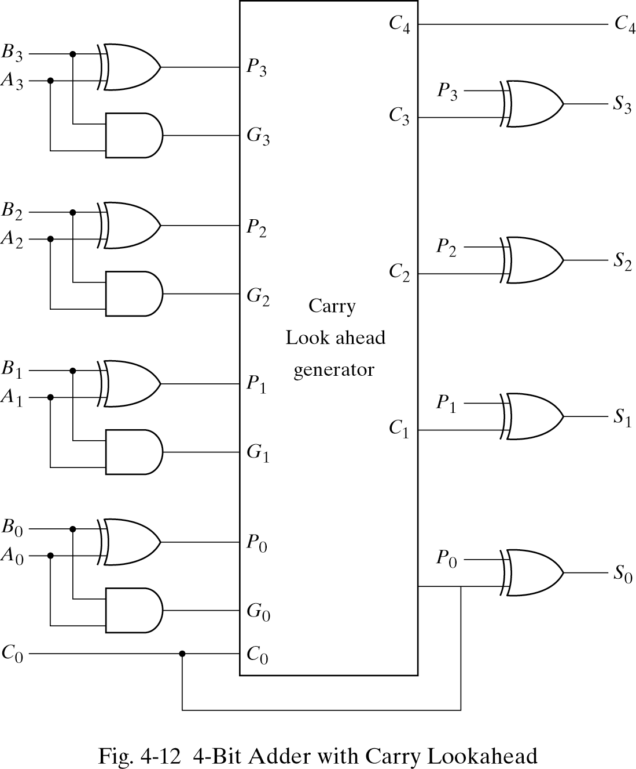
4-Bit Adder with Carry Lookahead

Slide 21
Binary Subtractor
Half Subtractor
Produces x -y
D – difference
D = x’y +xy’ = S of half adder
B = x’y
x
y
B
D
HS
x
- y
───
B D
x y | B D
0 0 | 0 0
0 1 | 1 1
1 0 | 0 1
1 1 | 0 0

Slide 22
Binary Adder
Full Subtractor
(x -y) –z; where z represents a borrow
x
y
z
D
B
FS
x y z | B D
0 0 0 | 0 0
0 0 1 | 1 1
0 1 0 | 1 1
0 1 1 | 1 0
1 0 0 | 0 1
1 0 1 | 0 0
1 1 0 | 0 0
1 1 1 | 1 1
 |  |  |  | y
 |  | 0 | 1 | 0 | 1
x |  | 1 | 0 | 1 | 0
 |  |  | z
D = xy'z'+x'yz'+x'y'z+xyz = x ⊕ y ⊕ z
 |  |  |  | y
 |  | 0 | 1 | 1 | 1
x |  | 0 | 0 | 1 | 0
 |  |  | z
B= x'y + x'z + yz

Slide 23
Binary Subtractor
Use 2’s complement with binary adder
x – y = x + (-y) = x + y’ + 1

Slide 24
Binary Adder/Subtractor
M: Control Signal (Mode)
M=0 ➔ F = x + y
M=1 ➔ F = x – y

Slide 25
Overflow
An overflow occurs when two number of n digits each are added and the sum occupies n+1 digits
When two unsigned numbers are added, an overflow is detected from the end carry out of the most significant position
When two signed numbers are added, the sign bit is treated as part of the number and the end carry does not indicate an overflow
Extra overflow detection circuits are required
An overflow can only occur when two numbers added are both positive or both negative

Slide 26
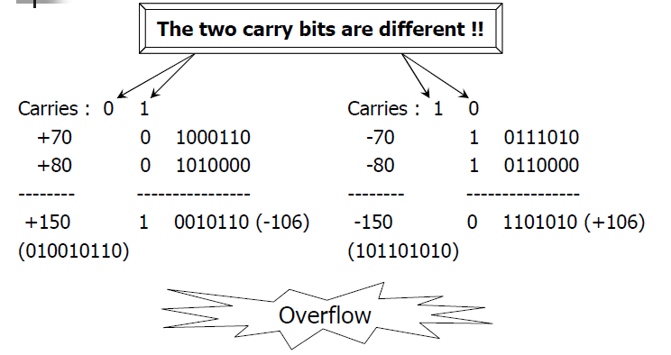
Overflow

Slide 27
Overflow
INPUTS |  |  | OUTPUTS
A_{sign} | B_{sign} | CARRY IN | CARRY OUT | SUM_{sign} | OVERFLOW
0 | 0 | 0 | 0 | 0 | 0
0 | 0 | 1 | 0 | 1 | 1
0 | 1 | 0 | 0 | 1 | 0
0 | 1 | 1 | 1 | 0 | 0
1 | 0 | 0 | 0 | 1 | 0
1 | 0 | 1 | 1 | 0 | 0
1 | 1 | 0 | 1 | 0 | 1
1 | 1 | 1 | 1 | 1 | 0

Slide 28
Overflow
x₃ x₂ x₁ x₀
y₃ y₂ y₁ y₀
Unsigned Binary Numbers
2’s Complement Numbers
0
FA
FA
FA
FA
Carry
C₄ C₃ C₂ C₁
S₃ S₂ S₁ S₀
x₃ x₂ x₁ x₀
y₃ y₂ y₁ y₀
0
FA
FA
FA
FA
Overflow
C₄ C₃ C₂ C₁
S₃ S₂ S₁ S₀

Slide 29
Decimal Adder
A decimal adder requires a minimum of 9 inputs
and 5 outputs
1 digit requires 4-bit
Input: 2 digits + 1-bit carry
Output: 1 digit + 1-bit carry
BCD adder
Perform the addition of two decimal digits in BCD, together with an input carry from a previous stage
The output sum cannot be greater than 19 (9+9+1)

Slide 30
BCD Adder
+ x₃ x₂ x₁ x₀
+ y₃ y₂ y₁ y₀
────────
Cy S₃ S₂ S₁ S₀
4-bits plus 4-bits
Operands and Result: 0 to 9
X +Y | x₃ x₂ x₁ x₀ | y₃ y₂ y₁ y₀ | Sum | Cy | S₃ S₂ S₁ S₀
0 + 0 | 0 0 0 0 | 0 0 0 0 | = 0 | 0 | 0 0 0 0
0 + 1 | 0 0 0 0 | 0 0 0 1 | = 1 | 0 | 0 0 0 1
0 + 2 | 0 0 0 0 | 0 0 1 0 | = 2 | 0 | 0 0 1 0
0 + 9 | 0 0 0 0 | 1 0 0 1 | = 9 | 0 | 1 0 0 1
1 + 0 | 0 0 0 1 | 0 0 0 0 | = 1 | 0 | 0 0 0 1
1 + 1 | 0 0 0 1 | 0 0 0 1 | = 2 | 0 | 0 0 1 0
1 + 8 | 0 0 0 1 | 1 0 0 0 | = 9 | 0 | 1 0 0 1
1 + 9 | 0 0 0 1 | 1 0 0 1 | = A | 0 | 1 0 1 0
Invalid Code
2 + 0 | 0 0 1 0 | 0 0 0 0 | = 2 | 0 | 0 0 1 0
9 + 9 | 1 0 0 1 | 1 0 0 1 | = 12 | 1 | 0 0 1 0
Wrong BCD Value
0001 1000

Slide 31
BCD Adder
X +Y | x₃ x₂ x₁ x₀ | y₃ y₂ y₁ y₀ | Sum | Cy | S₃ S₂ S₁ S₀ | Required BCD Output | Value
9 + 0 | 1 0 0 1 | 0 0 0 0 | = 9 | 0 | 1 0 0 1 | 0 0 0 0 1 0 0 1 | = 9
9 + 1 | 1 0 0 1 | 0 0 0 1 | = 10 | 0 | 1 0 1 0 | 0 0 0 1 0 0 0 0 | = 16
9 + 2 | 1 0 0 1 | 0 0 1 0 | = 11 | 0 | 1 0 1 1 | 0 0 0 1 0 0 0 1 | = 17
9 + 3 | 1 0 0 1 | 0 0 1 1 | = 12 | 0 | 1 1 0 0 | 0 0 0 1 0 0 1 0 | = 18
9 + 4 | 1 0 0 1 | 0 1 0 0 | = 13 | 0 | 1 1 0 1 | 0 0 0 1 0 0 1 1 | = 19
9 + 5 | 1 0 0 1 | 0 1 0 1 | = 14 | 0 | 1 1 1 0 | 0 0 0 1 0 1 0 0 | = 20
9 + 6 | 1 0 0 1 | 0 1 1 0 | = 15 | 0 | 1 1 1 1 | 0 0 0 1 0 1 0 1 | = 21
9 + 7 | 1 0 0 1 | 0 1 1 1 | = 16 | 1 | 0 0 0 0 | 0 0 0 1 0 1 1 0 | = 22
9 + 8 | 1 0 0 1 | 1 0 0 0 | = 17 | 1 | 0 0 0 1 | 0 0 0 1 0 1 1 1 | = 23
9 + 9 | 1 0 0 1 | 1 0 0 1 | = 18 | 1 | 0 0 1 0 | 0 0 0 1 1 0 0 0 | = 24
✗
✗
✗
✗
✗
✗
✗
✗
✗
+ 6

Slide 32
BCD Adder
Correct Binary Adder’s Output (+6)
If the result is between ‘A’ and ‘F’
If Cy = 1
S₃ S₂ S₁ S₀ | Err
0 0 0 0 | 0
1 0 0 0 | 0
1 0 0 1 | 0
1 0 1 0 | 1
1 0 1 1 | 1
1 1 0 0 | 1
1 1 0 1 | 1
1 1 1 0 | 1
1 1 1 1 | 1
 |  |  |  | S₁
 |  |  |  |  |  | S₂
S₃ |  | 1 | 1 | 1 | 1
 |  |  |  | 1 | 1
 |  |  | S₀
Err = S₃ S₂ + S₃ S₁

Slide 33
BCD Adder
Err

Slide 34
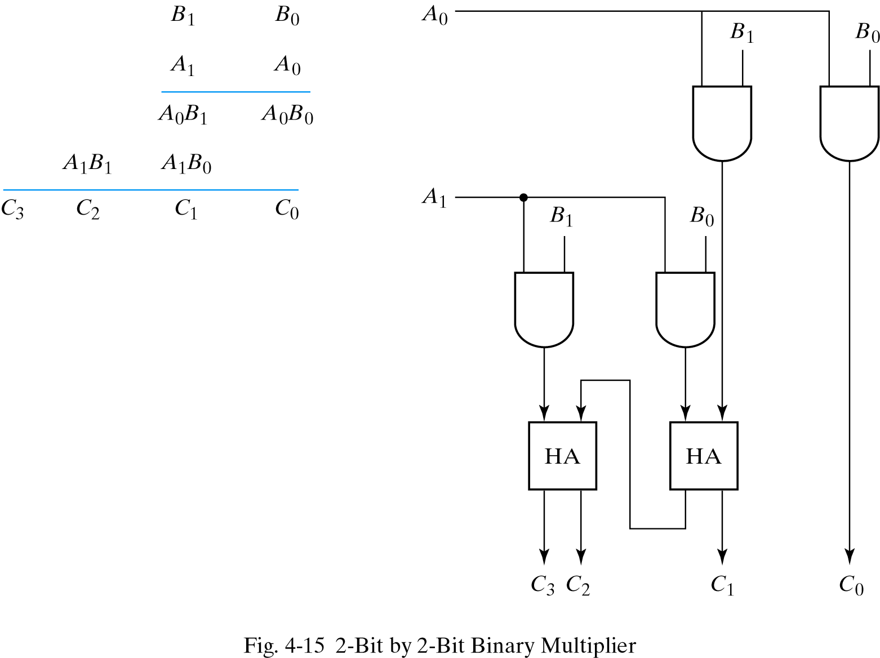
Binary Multipilier

Slide 35
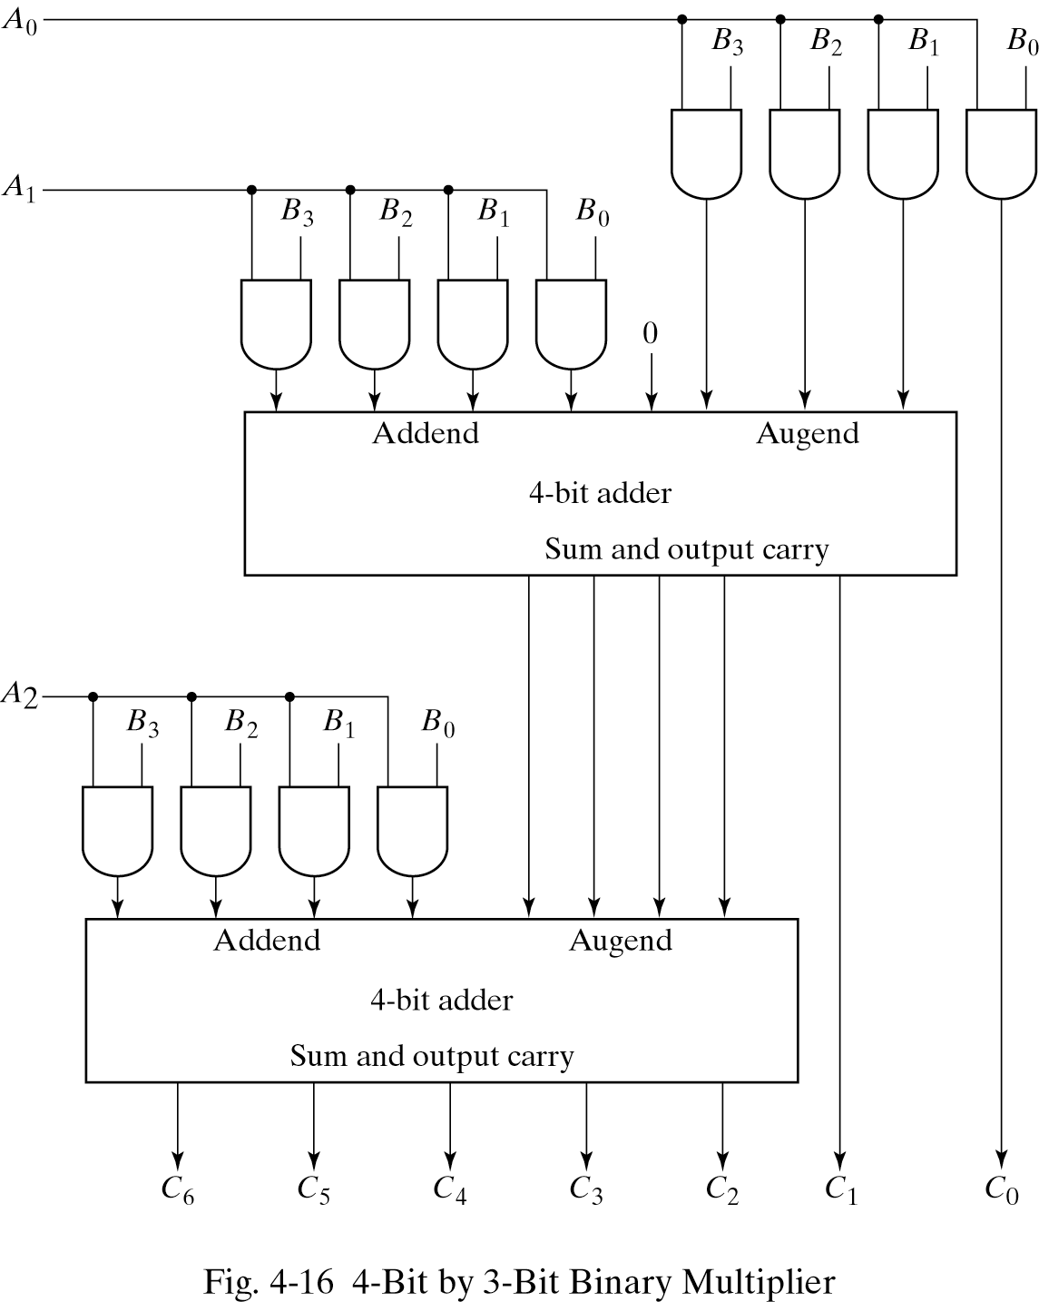
Binary Multipilier

Slide 36
Magnitude Comparator
Compare 4-bit number to 4-bit number
3 Outputs: < , = , >
Expandable to more number of bits
A₃A₂A₁A₀ B₃B₂B₁B₀
Magnitude Comparator
A<B A=B A>B

Slide 37
Magnitude Comparator

Slide 38
Decoders
A decoder is a combinational circuit that converts binary information from n input lines to an 2^{n} unique output lines.
1-to-2-Line Decoder

Slide 39
Decoders
Only one lamp will turn on
Extract “Information” from the code
Binary Decoder
Example: 2-bit Binary Number
0
1
2
3
Binary Decoder
1
0
0
0
x₁
x₀
0
0

Slide 40
Decoders
2-to-4 Line Decoder
Binary Decoder
Y₃
Y₂
Y₁
Y₀
I₁
I₀
I₁ I₀ | Y₃ Y₂ Y₁ Y₀
0 0 | 0 0 0 1
0 1 | 0 0 1 0
1 0 | 0 1 0 0
1 1 | 1 0 0 0

Slide 41
Decoders
3-to-8 Line Decoder
Binary Decoder
Y₇
Y₆
Y₅
Y₄ Y₃
Y₂
Y₁
Y₀
I₂
I₁
I₀

Slide 42
Decoders
Active-High / Active-Low
I₁ I₀ | Y₃ Y₂ Y₁ Y₀
0 0 | 0 0 0 1
0 1 | 0 0 1 0
1 0 | 0 1 0 0
1 1 | 1 0 0 0
I₁ I₀ | Y₃ Y₂ Y₁ Y₀
0 0 | 1 1 1 0
0 1 | 1 1 0 1
1 0 | 1 0 1 1
1 1 | 0 1 1 1
Binary Decoder
Binary Decoder
Y₃
Y₂
Y₁
Y₀
Y₃
Y₂
Y₁
Y₀
I₁
I₀
I₁
I₀

Slide 43
Decoders
“Enable” Control
Binary Decoder
Y₃
Y₂
Y₁
Y₀
I₁
I₀
E
E | I₁ I₀ | Y₃ Y₂ Y₁ Y₀
0 | x x | 0 0 0 0
1 | 0 0 | 0 0 0 1
1 | 0 1 | 0 0 1 0
1 | 1 0 | 0 1 0 0
1 | 1 1 | 1 0 0 0

Slide 44
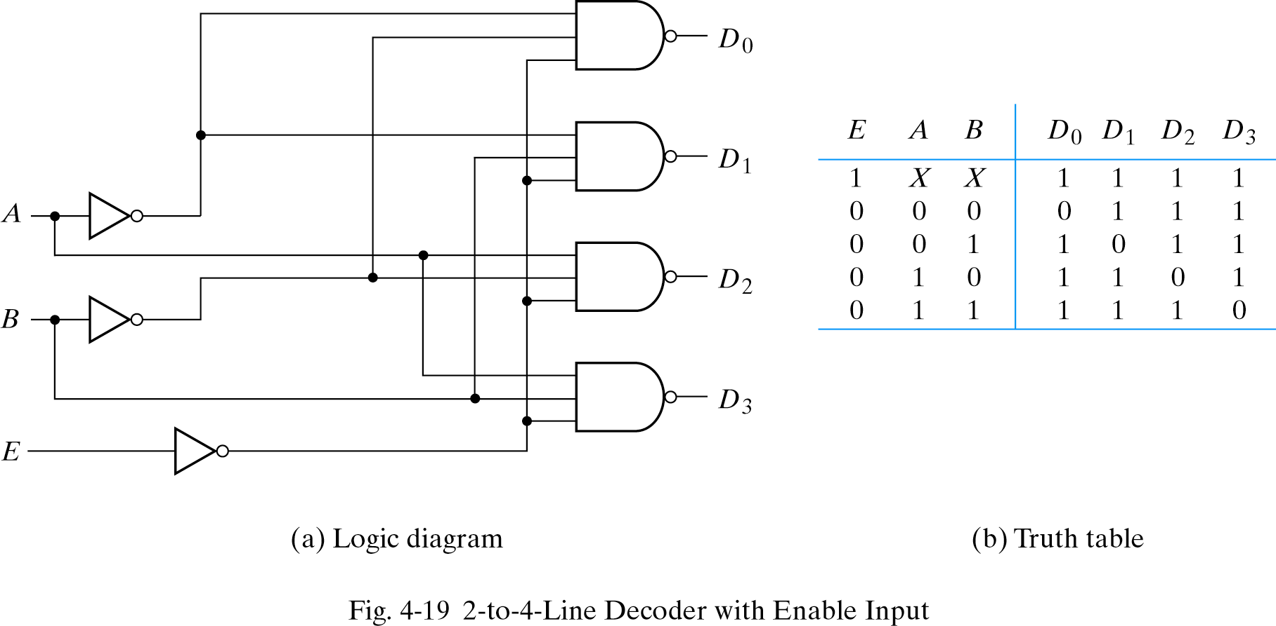
Decoders

Slide 45
Decoders
I₂ I₁ I₀
Expansion
I₂ I₁ I₀ | Y₇ Y₆ Y₅ Y₄ Y₃ Y₂ Y₁ Y₀
0 0 0 | 0 0 0 0 0 0 0 1
0 0 1 | 0 0 0 0 0 0 1 0
0 1 0 | 0 0 0 0 0 1 0 0
0 1 1 | 0 0 0 0 1 0 0 0
1 0 0 | 0 0 0 1 0 0 0 0
1 0 1 | 0 0 1 0 0 0 0 0
1 1 0 | 0 1 0 0 0 0 0 0
1 1 1 | 1 0 0 0 0 0 0 0
Binary Decoder
Y₃
Y₂
Y₁
Y₀
Y₇
Y₆
Y₅
Y₄
Y₃
Y₂
Y₁
Y₀
I₀
I₁
E
Binary Decoder
Y₃
Y₂
Y₁
Y₀
I₀
I₁
E

Slide 46
Implementation Using Decoders
Binary Decoder
Each output is a minterm
All minterms are produced
Sum the required minterms
Example: Full Adder
S(x, y, z) = ∑(1, 2, 4, 7)
C(x, y, z) = ∑(3, 5, 6, 7)
Y₇
Y₆
Y₅
Y₄ Y₃
Y₂
Y₁
Y₀
x
y
z
I₂
I₁
I₀
S C

Slide 47
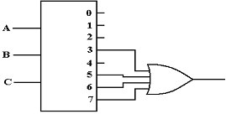
Implementation Using Decoders
F(x, y, z) = ∑(3, 5, 6, 7)
Active High Decoder, OR gate
SOP

Slide 48
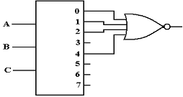
Implementation Using Decoders
F(x, y, z) = ∑(3, 5, 6, 7)
Active High Decoder, NOR gate
SOP->POS
F(x, y, z) = ∏(0, 1, 2, 4)

Slide 49
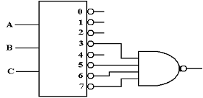
Implementation Using Decoders
F(x, y, z) = ∑(3, 5, 6, 7)
Active Low Decoder, NAND gate
SOP

Slide 50
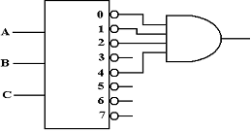
Implementation Using Decoders
F(x, y, z) = ∑(3, 5, 6, 7)
Active Low Decoder, AND gate
SOP->POS
F(x, y, z) = ∏(0, 1, 2, 4)

Slide 51
Encoders
Does reverse operation to decoder
An encoder has 2^{n} (or fewer) input lines and n output lines
Constraint – only one input is active at a time

Slide 52
Encoders
Binary Encoder
I₇
I₆
I₅
I₄ I₃
I₂
I₁
I₀
Octal-to-Binary Encoder (8-to-3)
I₇ I₆ I₅ I₄ I₃ I₂ I₁ I₀ | Y₂ Y₁ Y₀
0 0 0 0 0 0 0 1 | 0 0 0
0 0 0 0 0 0 1 0 | 0 0 1
0 0 0 0 0 1 0 0 | 0 1 0
0 0 0 0 1 0 0 0 | 0 1 1
0 0 0 1 0 0 0 0 | 1 0 0
0 0 1 0 0 0 0 0 | 1 0 1
0 1 0 0 0 0 0 0 | 1 1 0
1 0 0 0 0 0 0 0 | 1 1 1
Y₂
Y₁
Y₀

Slide 53
Priority Encoders
Encoder with priority function
Multiple inputs may be true simultaneously
Higher priority input gets the precedence

Slide 54
Priority Encoders
Priority Encoder
I₃
I₂
I₁
I₀
4-Input Priority Encoder
V
Y₁
Y₀
I₃ I₂ I₁ I₀ | Y₁ Y₀ | V
0 0 0 0 | x x | 0
0 0 0 1 | 0 0 | 1
0 0 1 x | 0 1 | 1
0 1 x x | 1 0 | 1
1 x x x | 1 1 | 1

Slide 55
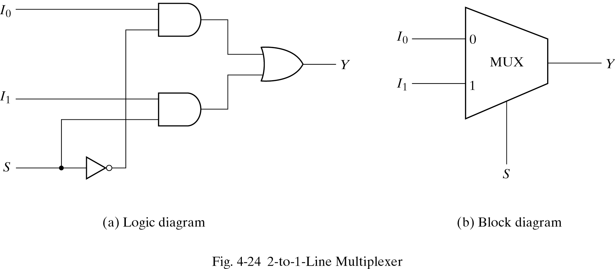
Multiplexers
A multiplexer is a combinational circuit that selects one of many input lines (2^{n}) and directs it to its single output line.
There are n selection lines whose bit combinations determine which input is selected.

Slide 56
Multiplexers
4-to-1 MUX
MUX
I₀
I₁
I₂
I₃
Y
S₁ S₀
S₁ S₀ | Y
0 0 | I₀
0 1 | I₁
1 0 | I₂
1 1 | I₃

Slide 57
Multiplexers
MUX
Z
I₀
I₁
I₂
I₃
Z
F
0
1
S₁ S₀
X
Y
S₁ S₀ | Y
0 0 | I₀
0 1 | I₁
1 0 | I₂
1 1 | I₃

Slide 58
Multiplexers
Quad 2-to-1 MUX
A₃
A₂
A₁
A₀
MUX
I₀
I₁
B₃
B₂
B₁
B₀
Y
S
MUX
I₀
I₁
Y
S
MUX
MUX
A₃
A₂
A₁
A₀
I₀
I₁
Y
S
Y₃
Y₂
Y₁
Y₀
MUX
B₃
B₂
B₁
B₀
I₀
I₁
Y
S
S
S E

Slide 59
Implementation Using Multiplexers
Example F(x, y) = ∑(0, 1, 3)
x y | F
0 0 | 1
0 1 | 1
1 0 | 0
1 1 | 1
MUX
1
1
0
1
I₀
I₁
I₂
I₃
Y
F
S₁ S₀
x y

Slide 60
Implementation Using Multiplexers
Example F(x, y, z) = ∑(1, 2, 6, 7)
x y z | F
0 0 0 | 0
0 0 1 | 1
0 1 0 | 1
0 1 1 | 0
1 0 0 | 0
1 0 1 | 0
1 1 0 | 1
1 1 1 | 1
MUX
0
1
1
0
0
0
1
1
I₀
I₁
I₂
I₃ I₄
I₅
I₆
I₇
Y
F
S₂ S₁ S₀
x y z

Slide 61
Implementation Using Multiplexers
F(x, y, z) = ∑(1, 2, 6, 7)
x y z | F
0 0 0 | 0
0 0 1 | 1
0 1 0 | 1
0 1 1 | 0
1 0 0 | 0
1 0 1 | 0
1 1 0 | 1
1 1 1 | 1
z
MUX
I₀
I₁
I₂
I₃
F = z
F
z
0
Y
F = z
1
S₁ S₀
F = 0
x y
F = 1

Slide 62
Implementation Using Multiplexers
F(A, B, C, D) = ∑(1, 3, 4, 11, 12, 13, 14, 15)
A B C D | F
0 0 0 0 | 0
0 0 0 1 | 1
0 0 1 0 | 0
0 0 1 1 | 1
0 1 0 0 | 1
0 1 0 1 | 0
0 1 1 0 | 0
0 1 1 1 | 0
1 0 0 0 | 0
1 0 0 1 | 0
1 0 1 0 | 0
1 0 1 1 | 1
1 1 0 0 | 1
1 1 0 1 | 1
1 1 1 0 | 1
1 1 1 1 | 1
MUX
D
I₀
I₁
I₂
I₃ I₄
I₅
I₆
I₇
F = D
D
F = D
D
F = D
0
Y
F
0
F = 0
D
F = 0
1
F = D
1
S₂ S₁ S₀
F = 1
F = 1
A B C

Slide 63
Implementation Using Multiplexers
Steps:
Complete the truth table from the SOP.
The first n – 1 variables in the table are applied to the selection inputs of the multiplexer.
For each combination of the selection variables, we evaluate the output as a function of the last variable.
Apply these values to the data input in proper order.

Slide 64
Multiplexer Expansion 8-to-1 MUX using Dual 4-to-1 MUX
MUX
I₀
I₁
I₂
I₃
I₄
I₅
I₆
I₇
I₀
I₁
I₂
I₃
Y
S₁ S₀
MUX
I₀
I₁
Y
Y
MUX
S
I₀
I₁
I₂
I₃
Y
S₁ S₀
1
0 0
S₂ S₁ S₀

Slide 65
DeMultiplexers
A decoder with enable input can function as a demultiplexer – a circuit receives information from a single line and directs it to one of 2^{n} possible output lines.

Slide 66
DeMultiplexers / Decoders
Binary Decoder
Y₃
Y₂
Y₁
Y₀
I₁
I₀
E
E | I₁ I₀ | Y₃ Y₂ Y₁ Y₀
0 | x x | 0 0 0 0
1 | 0 0 | 0 0 0 1
1 | 0 1 | 0 0 1 0
1 | 1 0 | 0 1 0 0
1 | 1 1 | 1 0 0 0
DeMUX
Y₃
Y₂
Y₁
Y₀
I
S₁ S₀

Slide 67
Demultiplexers
E | I₁ I₀ | Y₃ Y₂ Y₁ Y₀
0 | x x | 0 0 0 0
1 | 0 0 | 0 0 0 1
1 | 0 1 | 0 0 1 0
1 | 1 0 | 0 1 0 0
1 | 1 1 | 1 0 0 0

Slide 68
Three-State Gates
Tri-State Buffer
Tri-State Inverter
C A | Y
0 x | Hi-Z
1 0 | 0
1 1 | 1
A
Y
C
A
Y
C

Slide 69
Three-State Gates 2-to-1-line mux
A
C
A if C = 1
B if C = 0
Y=
B

Slide 70
Three-State Gates 4-to-1-line mux
I₃
I₂
Y
I₁
I₀
Binary Decoder
Y₃
Y₂
Y₁
Y₀
S₁
I₁
I₀
E
S₀
E

Slide 71
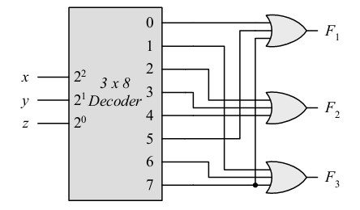
Practice
Using a decoder and external gates, design the combinational circuit defined by the following three boolean functions:
F₁ = x’ y’z’ + xz = ∑ (0, 5, 7)
F₂ = xy’z’ + x’y = ∑ (2, 3, 4)
F₃ = x’y’z + xy = ∑ (1, 6, 7)

Slide 72
Practice
A combinational circuit is specified by the following three boolean functions:
F₁ (A, B, C) = ∑ (2, 4, 7)
F₂ (A, B, C) = ∑ (0, 3)
F₃ (A, B, C) = ∑ (0, 2, 3, 4, 7)
Implement the circuit with a decoder constructed with NAND gates.

Slide 73
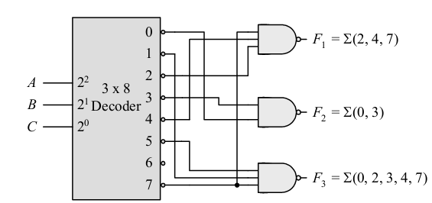
Practice

Slide 74
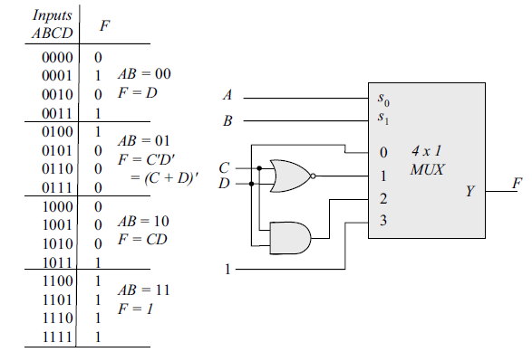
Practice
Implement the following Boolean function with a 4 X 1 multiplexer and external gates.
F(A, B, C, D) = ∑ (1, 3, 4, 11, 12, 1 3, 14, 15)

Slide 75
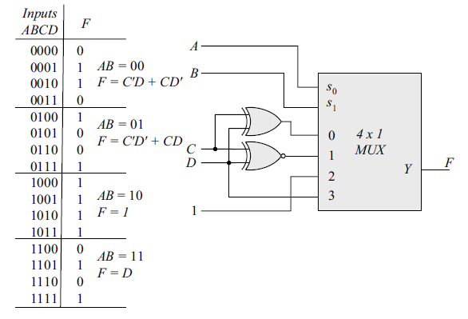
Practice
Implement the following Boole an function with a 4 X 1 multiplexer and external gates.
F(A, B, C, D) = ∑ (1, 2, 4, 7, 8, 9, 10, 11, 13, 15)

Slide 76
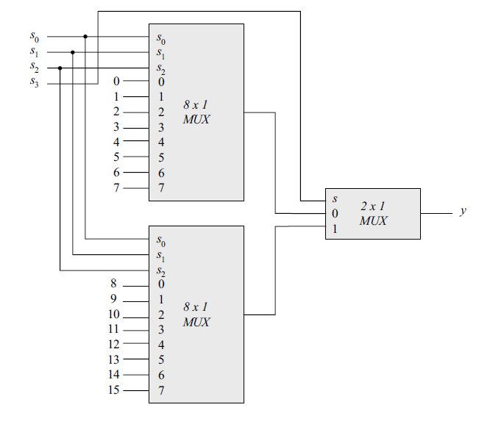
Practice
Construct a 16 X 1 multiplexer with two 8 X 1 and one 2 X 1 multiplexers. Use block diagrams

Slide 77
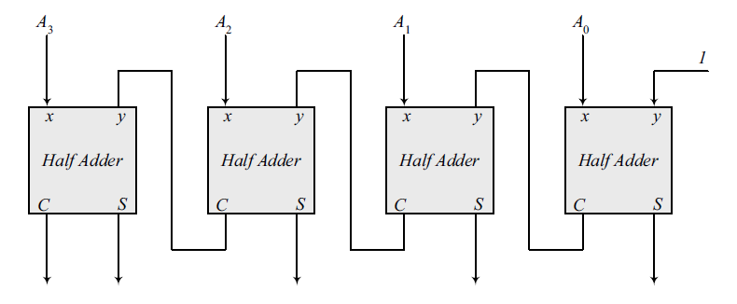
Practice
Using four half-adders design a 4-bit combinational circuit incrementer (a circuit that adds 1 to a 4-bit binary number)

Slide 78
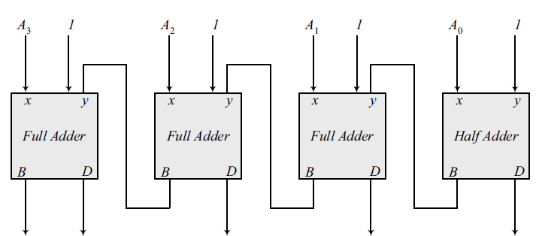
Practice
Using a half-adder and three full-adeders design a 4-bit combinational circuit decrementer (a circuit that subtracts 1 from a 4-bit binary number)

Slide 79
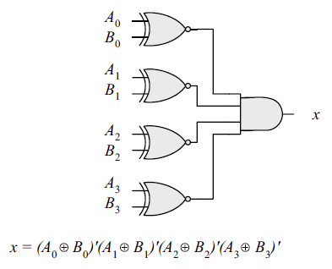
Practice
Design a combinational circuit that compares two 4-bit numbers to check if they are equal. The circuit output is equal to 1 if two numbers are equal and 0 otherwise.

